Slide 1
PBJ5: Systems vaccinology of the BNT162b2 mRNA vaccine in humans
Arunachalam, et al. Nature. 2021
Megan Costa, Harsha Tamtam, Kamari Weaver

Slide 2
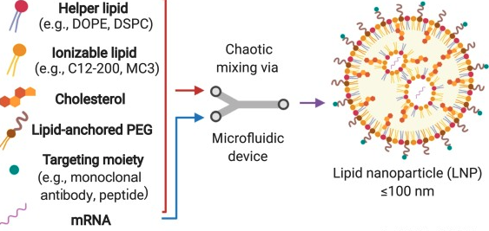
Overview of BNT162b2 vaccine
Kelsey et al., Trends in Mol. Biol. https://doi.org/10.1016/j.molmed.2021.03.003.
Notes:
Lipid nanoparticle is intramuscularly injected, diffuses into cells to then be translated into the RBD spike protein

Slide 3
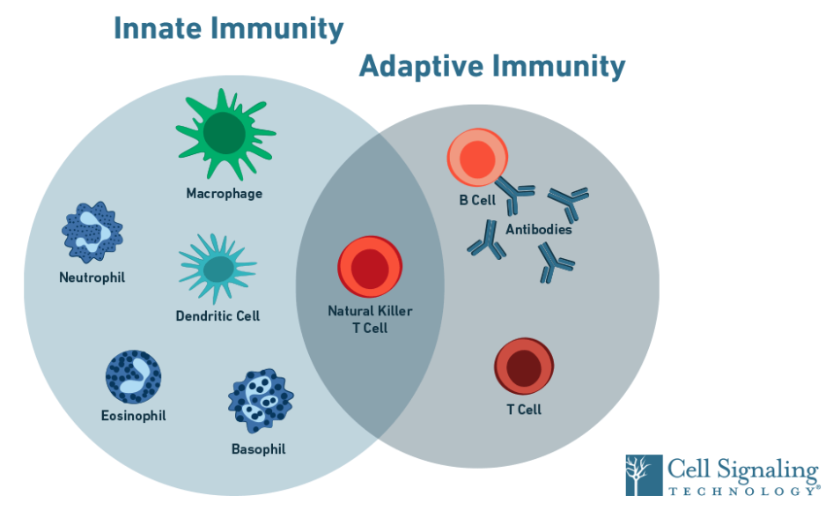
Innate and Adaptive Immune Response
Notes:
Innate Immune Response: TLRs, Caspase Cascade, Complement Activation, Granzyme activity, Macrophage response
Especially with IL-1B/IL-2 and TNF-a responses
Adaptive Immune Response: B cell response, T cell Response
TNF-gamma

Slide 4
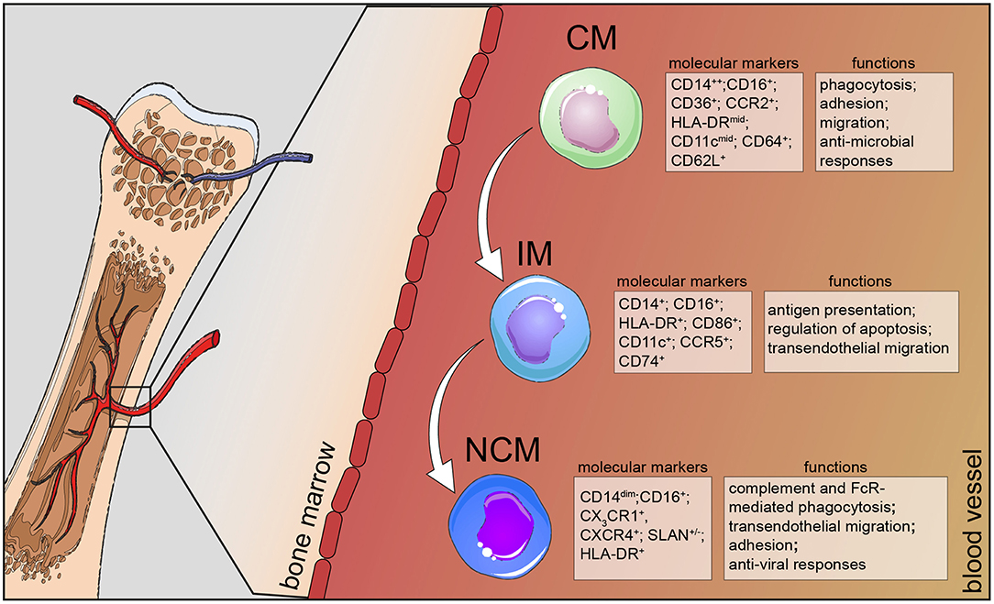
Human Monocytes
Kapellos et al., Front. Immunol. https://doi.org/10.3389/fimmu.2019.02035.

Slide 5
Human Monocytes
Classical monocytes (CD14+ CD16-): migrates to the inflammation site, produces inflammatory mediators and performs phagocytosis to repair tissues
Non-classical monocytes (CD14+ CD16++): display inflammatory characteristics on activation and can present antigens
Intermediate monocytes (CD14+ CD16+): recently defined subset previously characterized with the non-classical group, has phagocytic and inflammatory properties

Slide 6
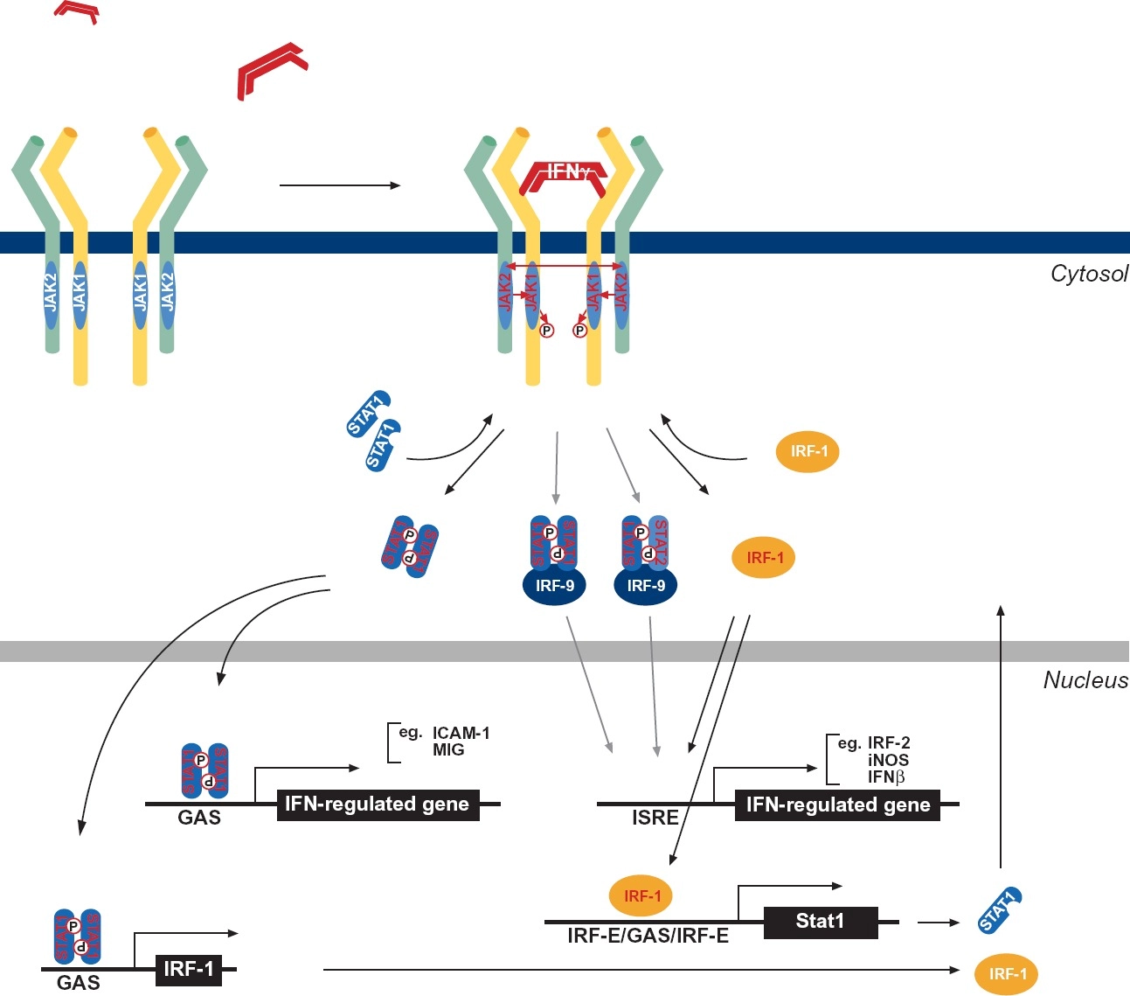
IFNγ
Castro et al., Front. Immunol. https://doi.org/10.3389/fimmu.2018.00847.

Slide 7
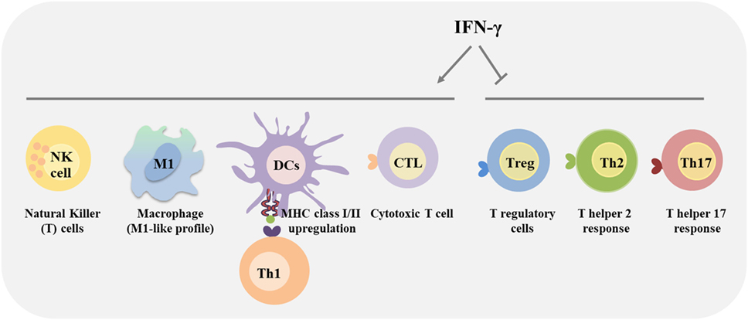
IFNγ
Castro et al., Front. Immunol. https://doi.org/10.3389/fimmu.2018.00847.
Notes:
Megan

Slide 8
Questions to be Addressed:
Investigate the innate immune response to the BNT162b2 mRNA vaccines
Notes:
Kamari

Slide 9
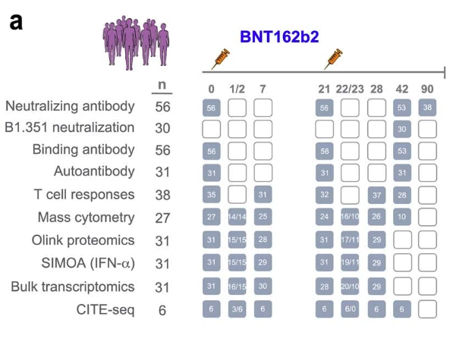
Study Design
Systems immunology to characterize immune responses in 56 vaccinated volunteers
Extended Figure 1
Assess antibody and T cell, innate immune, and transcriptional responses. Compares to other vax
Notes:
Kamari

Slide 10
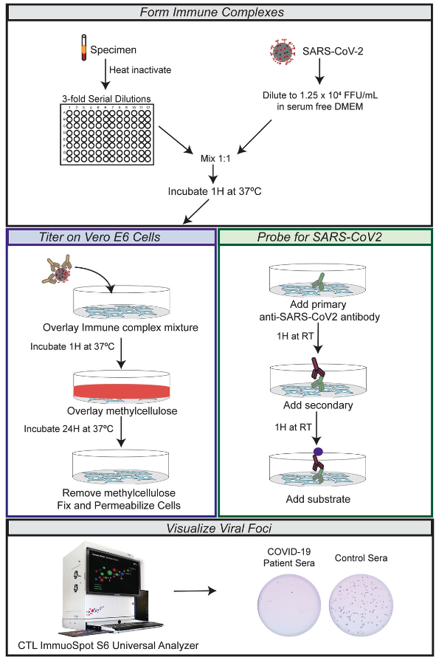
Focus reduction neutralization titre (FRNT) assay
Notes:
Harsha

Slide 11
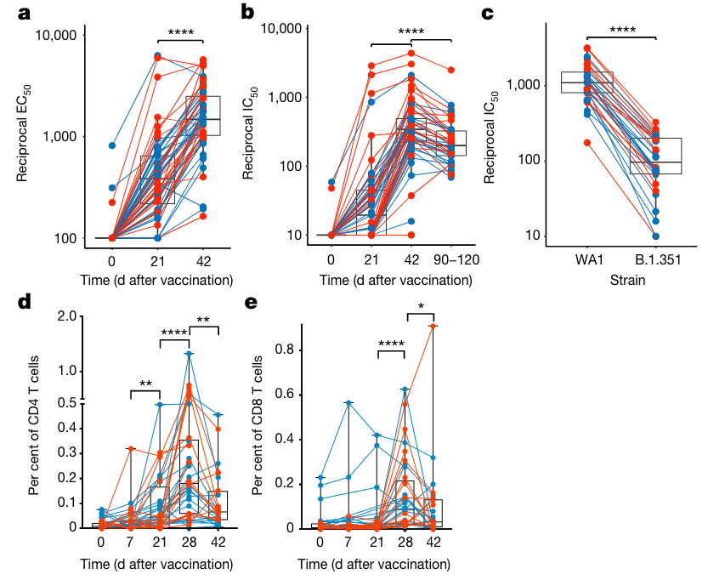
Figure 1 | BNT162b2 vaccination induces robust antibody and T cell responses
Notes:
Harsha

Slide 12
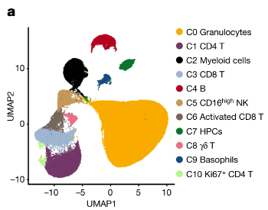
Cytometry by Time of Flight (CyTOF)
Figure 2 | Innate immune responses induced by BNT162b2 vaccination
New method for identifying populations of cells
Probes labeled with metal isotopes that emit sharper signal
Provides more parameters to quantify and more information from samples
Assessed whole-blood samples of 27 volunteers using CyTOF - Identifies 14 major cell types
Notes:
Kamari

Slide 13
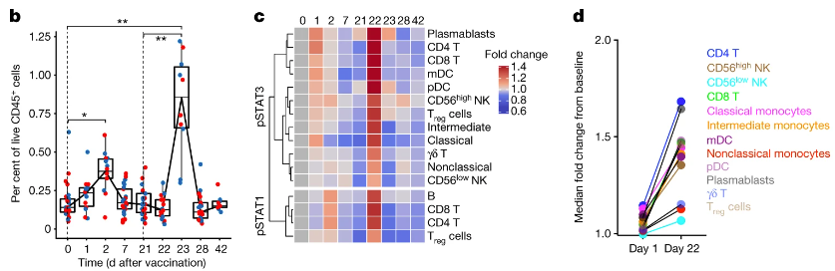
Figure 2 | Innate immune responses induced by BNT162b2 vaccination
Intermediate monocytes increase substantially after second vax
Enhanced pSTAT levels in multiple cell types after second vax
Conclusion: BNT162b2 vax elicits heighted innate immune response after second vax compared to first vax
Notes:
Kamari

Slide 14
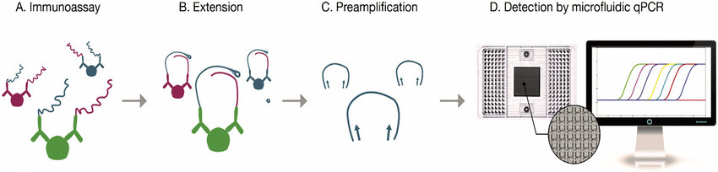
Olink multiplex proximity assay (PEA)
Method to measure cytokines in plasma
Notes:
Kamari

Slide 15
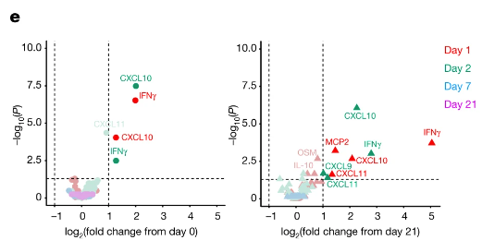
Figure 2 | Innate immune responses induced by BNT162b2 vaccination
[ ] of cytokines increase after primary vax
[ ] of cytokines increase even further after second vax
Notes:
Kamari

Slide 16
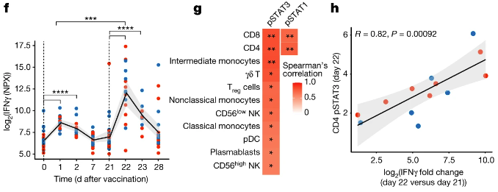
Figure 2 | Innate immune responses induced by BNT162b2 vaccination
[ ] of plasma IFNy significantly higher at day 22 than day 1
IFNy and pSTAT expression levels correlate
Conclusion: BNT vax elicit modest innate immune response after primary vax, which increases considerably after second vax
Notes:
Kamari

Slide 17
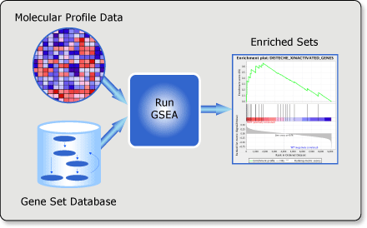
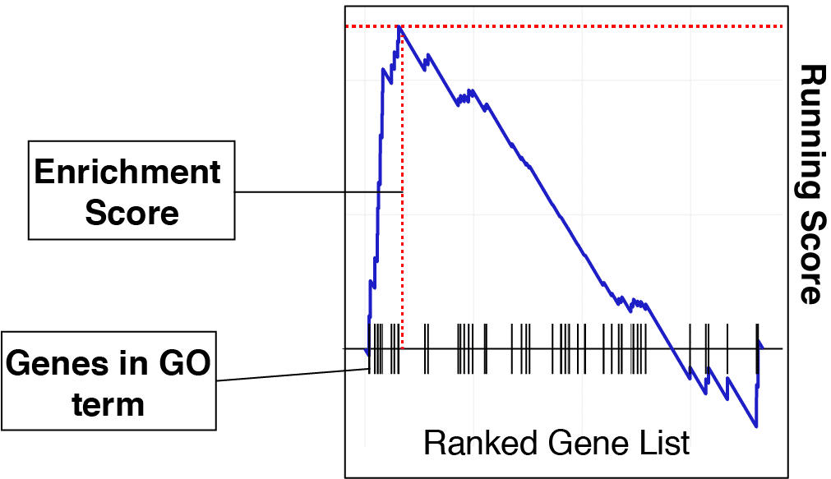
Gene set enrichment analysis (GSEA)

Slide 18
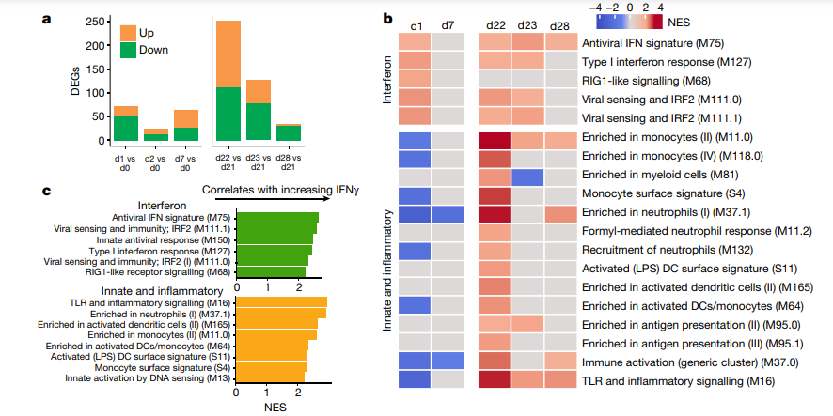
Figure 3 | Transcriptional signatures of BNT162b2 vaccination

Slide 19
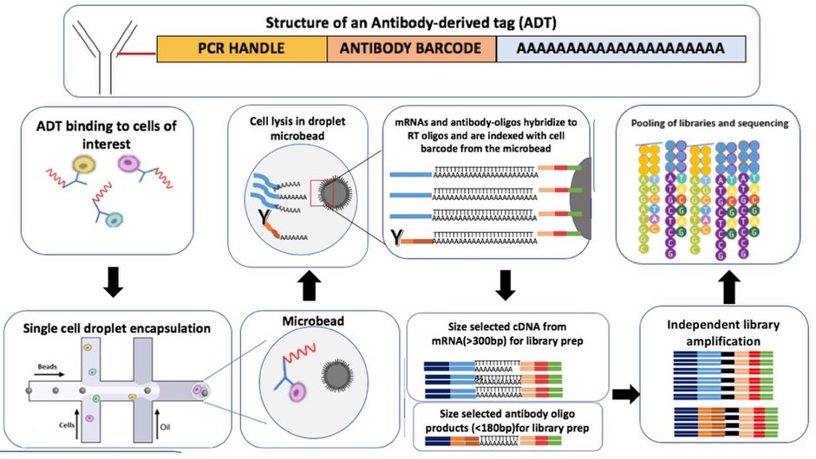
CITE-seq

Slide 20
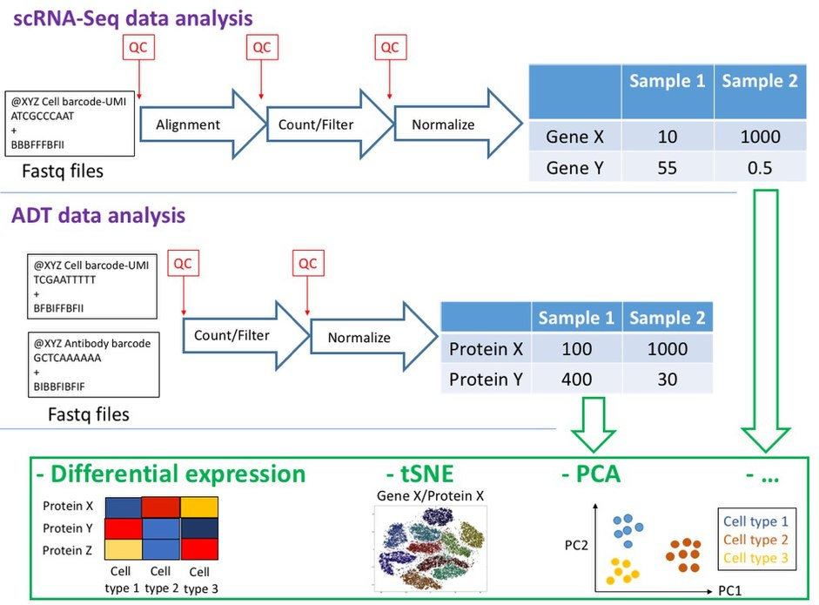
CITE-seq

Slide 21
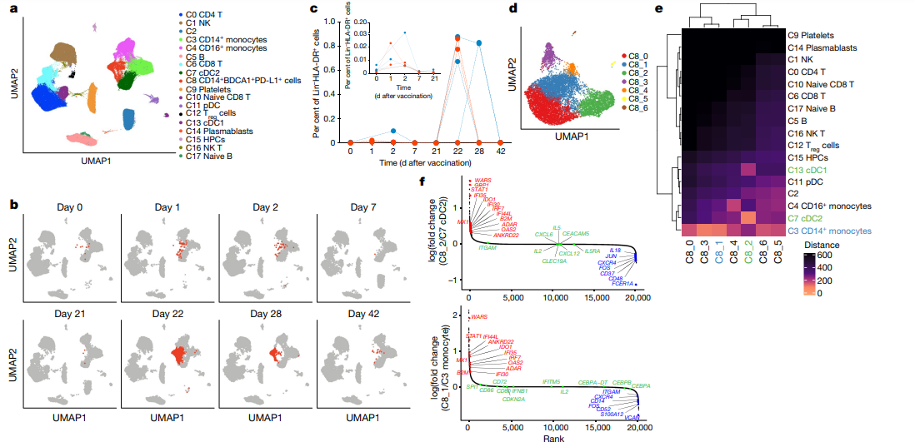
Figure 4 | Single-cell transcriptional response to BNT162b2 vaccination

Slide 22
Figure 4 | Single-cell transcriptional response to BNT162b2 vaccination
STAT1 = antiviral response
FOS and JUN = pro-inflammatory

Slide 23
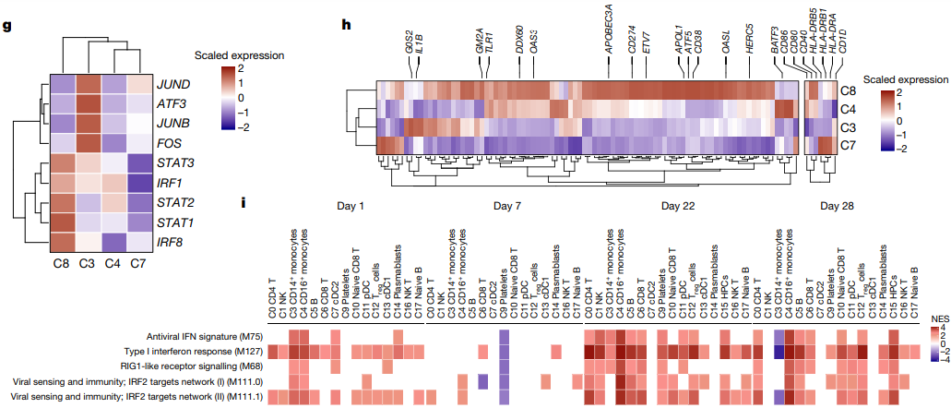
Figure 4 | Single-cell transcriptional response to BNT162b2 vaccination

Slide 24
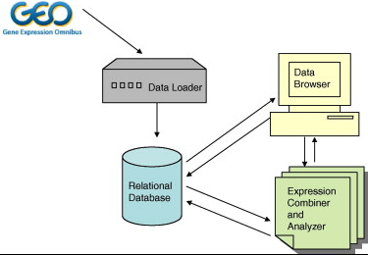
Vaccine dataset meta-analysis (GEO)
Lacson, et al., 2010. doi.org/10.1016/j.jbi.2010.04.007
Notes:
Harsha
GEO is a public functional genomics data repository
The Data Loader stores data directly imported from GEO into the Relational Database
Relational Database holds data queries for future use through algorithms
The Data Browser provides a web front end to the Relational Database
EC and Analyzer provides methods to combine data from different studies, when deemed appropriate by a user.

Slide 25
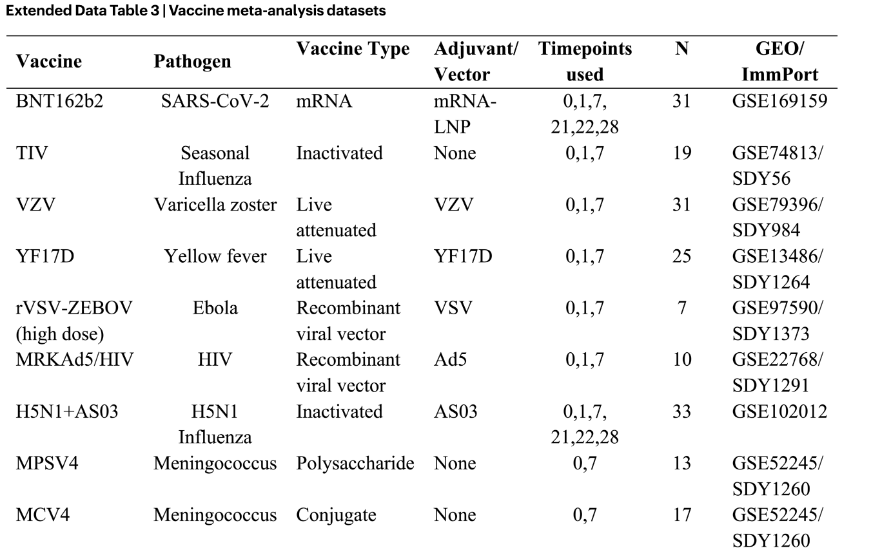
Vaccine dataset meta-analysis con’t.
Notes:
Harsha

Slide 26
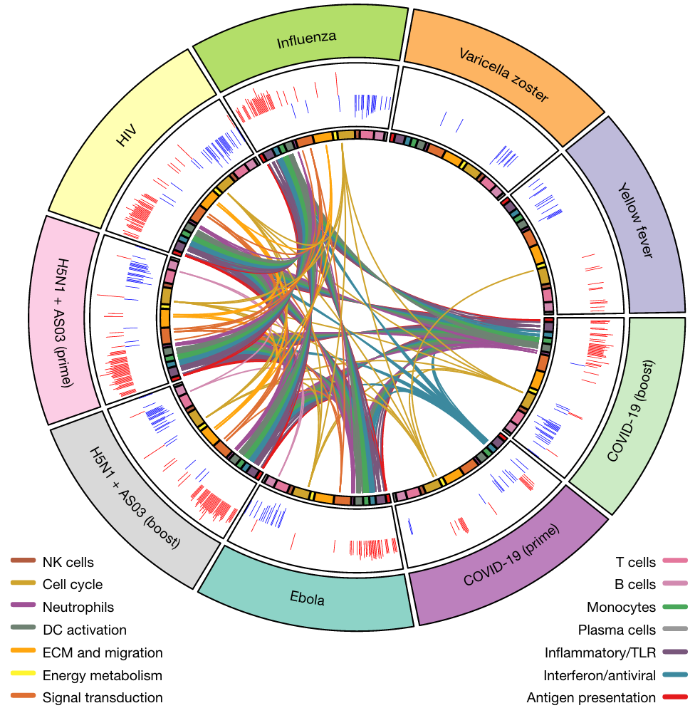
Figure 5 | Comparison of transcriptional responses with other vaccines
Notes:
Harsha

Slide 27
Main Takeaways
Pfizer vaccination stimulates antibody response and antigen recognition over time
Modest innate immune response after the first vaccination, which increases substantially after the second vaccination
Both doses stimulated antiviral and inflammatory responses, with the booster dose triggering a broader innate immune response
Cluster 8 is a heterogeneous immune cell mixture, active one day after booster, that uniquely expressed IFN-stimulated genes
BTMs (DCs, Monocytes, Neutrophils, TLRs, and Antigen presentation), excluding interferon/antiviral, demonstrate more gene perturbations after Pfizer booster

Slide 28
Study Limitations
Sample size is low in some of the analyses (i.e., 6 individuals in single-cell)
Figure 4(b) shows cluster C8 that shows varied projections. What is this change’s biological relevance?

Slide 29
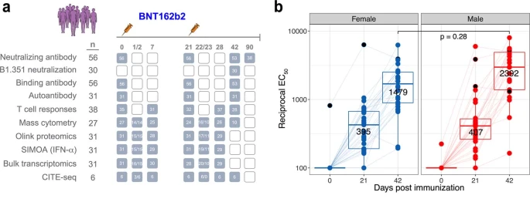
Study Limitations con’t.
Extended Data Figure 1 contains important information about the sample size, presents the data in a more digestible and visually appealing manner, and could easily be substituted for Figure 1.

Slide 30
Discussion/Applications
Comparison of the 2 Pfizer vaccines with other established vaccines inevitably leaves the reader with more questions — what other vaccines would you like to see included in the study and are there any further comparisons that could be drawn?
STAT1 gain of function mutations underlie a variety of infectious, autoimmune diseases, and carcinomas (Toubiana et al. Blood. 2016.). Is the upregulation of STAT1 following vaccination concerning? Or would the upregulation of IFNγ (which is anti-tumorigenic) compensate?

Slide 31
Questions?

